Slide 1
EE 152-BASIC ELECTRONICS
P. Asigri
Department of Electrical & Electronic Engineering
College of Engineering
August 2022

Slide 2
CHAPTER FIVE
BIPOLAR JUNCTION TRANSISTORS

Slide 3

What to expect?
Introduction
Operation of a transistor
Transistor Configurations

Slide 4
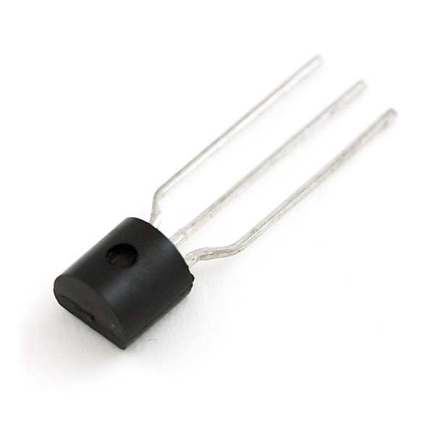
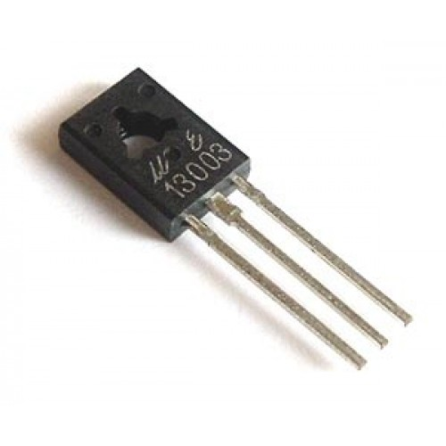
1. BIPOLAR JUNCTION TRANSISTORS
A transistor is a three terminal solid state semiconductor device commonly used as an amplifier or a switch.

Slide 5
Introduction
A bipolar junction transistor is a three-terminal solid-state semiconductor device commonly used as an amplifier or a switch.
The word “transistor” is a combination of the two words “transfer varistor”.
Current conduction in the transistor is based on the movement of two majority current carriers (holes and electrons).
The term bipolar denotes this condition of conduction.
Notes:
A varistor is an electronic component with an electrical resistance that varies with the applied voltage. Also known as a voltage-dependent resistor (VDR), it has a nonlinear, non-ohmic current–voltage characteristic that is similar to that of a diode.
The device is often called the bipolar junction transistor because its operation requires that the negatively charged electrons and their positively charged counterparts (the holes corresponding to an absence of electrons in the crystal lattice) coexist briefly in the presence of one another.

Slide 6
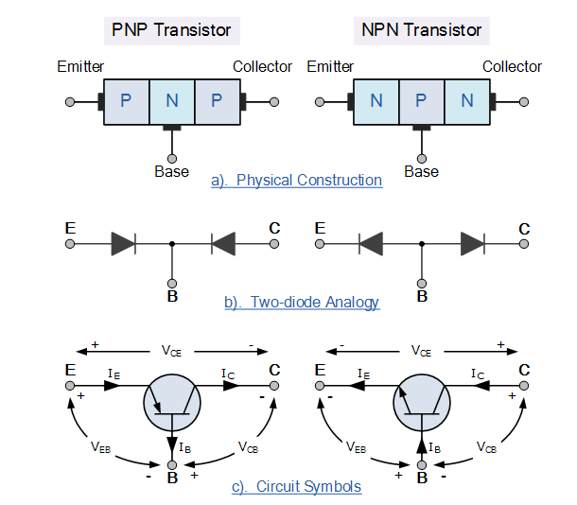
Bipolar Transistor Construction
A transistor consists of two PN junctions formed by sandwiching either p-type or n-type semiconductors between pairs of opposite types.
Accordingly, there are two types of transistors, namely:
NPN transistor
PNP transistor

Slide 7
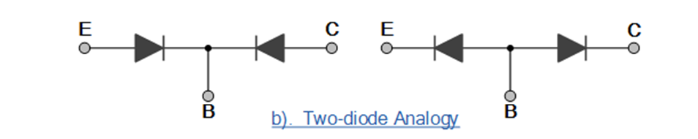
Bipolar Transistor Construction
Diodes are made from two pieces of semiconductor material to form a simple pn junction.
When two individual diodes are joined back-to-back, we get two pn junctions connected together in series that share a common P or N terminal.

Slide 8

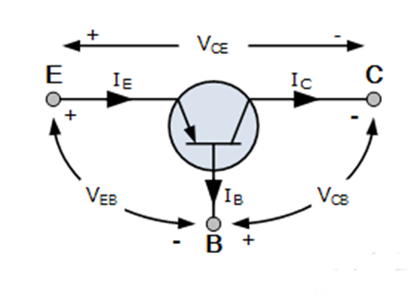
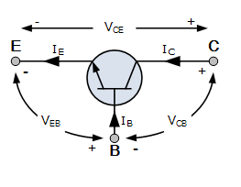
Terminals of a Bipolar Transistor
The three (3) terminals of a BJT(NPN or PNP) are:
Emitter (E)
Base (B)
Collector (C)

Slide 9
Terminals of a Bipolar Transistor
The junction between emitter and base is called the emitter-base junction while the junction between the collector and base is called the collector-base junction.
Base (B)
The base is thin and lightly doped.
By making the base very thin and the impurity concentration in the base much less than in the emitter and collector, free electrons(holes) emerging from the emitter have little chance of combining with the holes(electrons) in the base with the result that only about 98% of these electrons(holes) reach the collector.

Slide 10
Terminals of a Bipolar Transistor
Emitter (E)
The emitter is heavily doped.
Its main function is to supply the majority charge carriers (either electrons or holes) to the base.
It is wider when compared to the base.
Collector (C)
The collector is moderately doped.
Its main function is to collect the majority charge carriers coming from the emitter and passing through the base.
The width of the collector is more when compared to both the base and emitter to help dissipate heat that might be associated with the operation of the transistor.

Slide 11
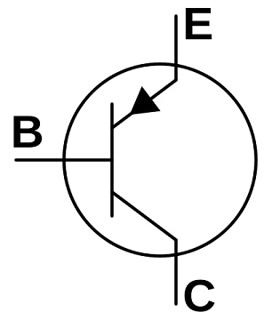
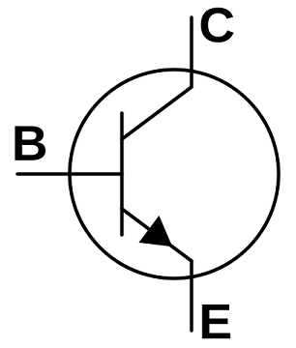
PNP vs NPN Transistor
In order to distinguish the emitter and collector, an arrow is included on the emitter.
For a PNP transistor, the arrowhead points from emitter to base meaning that the emitter is positive with respect to the base.
For an NPN transistor, the arrowhead points from base to emitter meaning that the base is positive with respect to the emitter.

Slide 12
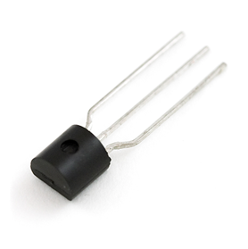
2. OPERATION OF A TRANSISTOR
How does a transistor work?

Slide 13
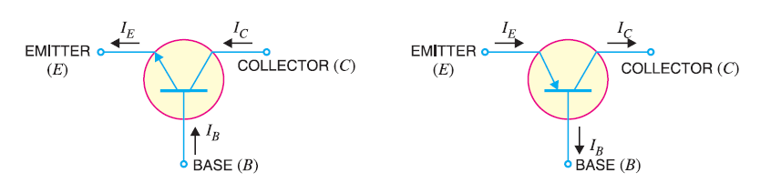
Transistor Currents
There are three currents in a transistor:
Emitter Current, I_{E}
Collector Current, I_{C}
Base Current, I_{B}

Slide 14
Operating Regions of a Transistor
A transistor can be operated in three different regions as:
active region,
saturation region
cut-off region
MODE | EMITTER BASE JUNCTION (EBJ) | COLLECTOR BASE JUNCTION (CBJ) | PURPOSE
ACTIVE | Forward | Reverse | Amplification
SATURATION | Forward | Forward | Switching
CUT-OFF | Reverse | Reverse | Switching
Notes:
The transistor operates in active region when the emitter junction is forward biased and collector junction is reverse biased. In the active state, collector current is β times the base current
this is the region in which transistor tends to behave as a closed switch. The transistor has the effect of its collector and Emitter being shorted. The collector and Emitter currents are maximum in this mode of operation.
This is the region in which transistor tends to behave as an open switch. The transistor has the effect of its collector and base being opened. The collector, emitter and base currents are all zero in this mode of operation.

Slide 15
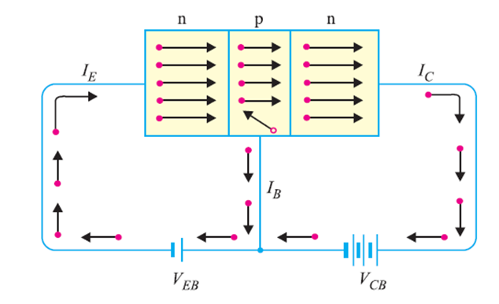
Theory of Operation of an NPN transistor
Working of an NPN transistor in the Active Region
In the NPN transistor, the emitter-base junction is forward biased while the collector-base junction is reversed bias.
The forward bias causes the electrons in the n-type emitter to flow towards the base.
This constitutes the emitter current, I_{E}.

Slide 16
Theory of Operation of an NPN transistor
Working of an NPN transistor in the Active Region
As these electrons flow through the p-type base, they tend to combine with holes.
As the base is lightly doped and very thin, only few electrons (less than 5%) combine with holes to constitute base current I_{B}.
The remainder (more than 95%) cross over into the collector region to constitute collector current I_{C}.

Slide 17
Theory of Operation of an NPN transistor
Working of an NPN transistor in the Active Region
In this way, almost the entire emitter current flows in the collector circuit.
It is clear that emitter current is the sum of collector and base current.
I_{E} = I_{C} + I_{B}

Slide 18
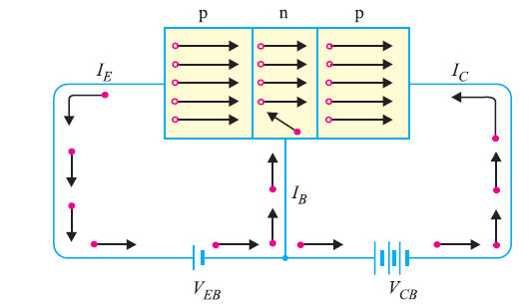
Theory of Operation of an PNP transistor
Working of a PNP transistor in the Active Region
In the PNP transistor, the emitter-base junction is forward biased while the collector-base junction is reversed bias.
The forward bias causes the holes in the p-type emitter to flow towards the base.
This constitutes the emitter current I_{E}.

Slide 19
Theory of Operation of an PNP transistor
Working of a PNP transistor in the Active Region
As these holes cross into n-type base, they tend to combine with the electrons.
As the base is lightly doped and very thin, only a few holes (less than 5%) combine with the electrons.
The remainder (more than 95%) cross into the collector region to constitute the collector current, I_{C.}

Slide 20
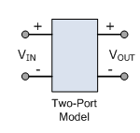
3. TRANSISTOR CONFIGURATIONS
A transistor has three terminals.
When it is connected in a circuit, we require four terminals:
Two for the input and two for the output.
This difficulty is overcome by making one terminal of the transistor common to both the input and output

Slide 21
Bipolar Transistor Configurations
There are basically three possible ways to connect it within an electronic circuit with one terminal being common to both the input and output.
Each method of connection responds differently to its input signal within a circuit as the static characteristics of the transistor vary with each circuit arrangement.
There are three transistor configurations:
Common Base Configuration
Common Emitter Configuration
Common Collector Configuration

Slide 22
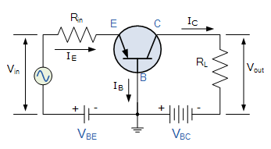
Common Base Configuration
In the Common Base or Grounded Base configuration, the BASE connection is common to both the input signal and the output signal.
The input signal is applied between the base and emitter terminals, while the output signal is taken from between the base and the collector terminals as shown.
The base terminal is grounded or can be connected to some fixed reference voltage point.

Slide 23
Common Base Configuration
The input current flowing into the emitter is quite large as its the sum of both the base current and collector current.
The collector current output is less than the emitter current input resulting in a current gain for this type of circuit of “1” (unity) or less.
In other words the common base configuration “attenuates” or weakens the input signal.

Slide 24
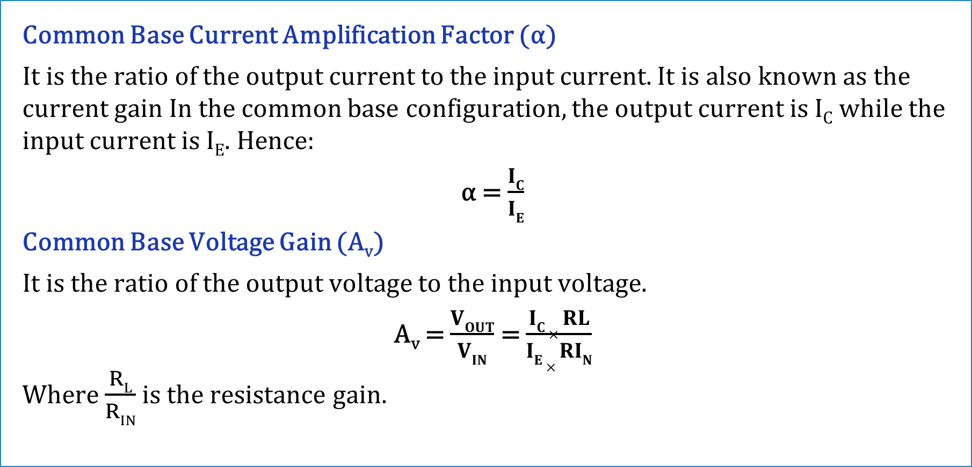
Common Base Configuration
Common Base Current Amplification Factor (α)
It is the ratio of the output current to the input current. It is also known as the current gain In the common base configuration, the output current is I_{C} while the input current is I_{E}. Hence:
α = $\frac{IC}{IE}$
Common Base Voltage Gain (A_{v})
It is the ratio of the output voltage to the input voltage.
A_{v} = $\frac{VOUT}{VIN}$ = $\frac{IC × RL}{IE × RIN}$
Where $\frac{RL}{RIN}$ is the resistance gain.

Slide 25
Common Base Configuration
Things to note
This type of amplifier configuration is a non-inverting voltage amplifier circuit, in that the signal voltages V_{in} and V_{out} are “in-phase”.
This type of transistor arrangement is not very common due to its unusually high voltage gain characteristics.
Its input characteristics represent that of a forward-biased diode while the output characteristics represent that of an illuminated photo-diode.

Slide 26
Common Base Configuration
Things to note
This type of bipolar transistor configuration has a high ratio of output to input resistance or more importantly “load” resistance ( R_{L} ) to “input” resistance ( R_{in} ) giving it a value of “Resistance Gain”.
The common base circuit is generally only used in single-stage amplifier circuits such as microphone pre-amplifier or radio frequency ( R_{ƒ} ) amplifiers due to its very good high-frequency response.

Slide 27
Common Base Configuration
Transistor Characteristics
These are the curves which represent the relationship between different DC currents and voltages of a transistor.
There are two main transistor characteristics: input and output characteristics.
Transistor characteristic curves are helpful in studying the operation of a transistor when connected to a circuit.
The static characteristics of an NPN transistor connected in a common-base configuration can be determined by the use of the test circuit shown below.

Slide 28
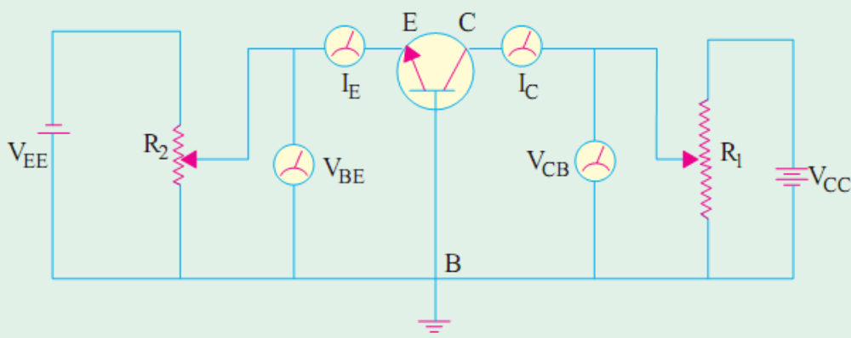
Common Base Configuration
Transistor Characteristics
Milliammeters are included in series with the emitter and collector circuits to measure I_{E} and I_{C}. Similarly, voltmeters are connected across E and B to measure voltage V_{BE} and across C and B to measure V_{CB}. The two potentiometer resistors R₁ and R₂ supply variable voltages from the collector and emitter DC supplies respectively

Slide 29
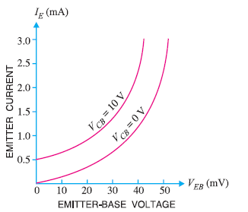
Common Base Configuration
Input Characteristics
The input characteristic is a curve between I_{E} and emitter base voltage V_{BE}, keeping V_{CB} constant.
I_{E} is taken along the y-axis and V_{BE} is taken along the x-axis.
This is called the input characteristic because the base-emitter will become the input terminals.

Slide 30
Common Base Configuration
Input Characteristics
First, voltage V_{CB} is adjusted to a suitable value with R₁.
Next, voltage V_{BE} is increased in a number of discrete steps and corresponding values of I_{E} are noted from the milliammeter connected for the purpose.
When plotted, we get the input characteristic curve.

